Slide 1
KNOWLEDGE ENGINEERING IN FIRST-ORDER LOGIC EXPERT SYSTEM
GROUP Members:
SIRAT UN NISA (FA23-BCS-161)
AROOJ MAZHAR (FA23-BCS-164)
FAIZA ILYAS (FA23-BCS-178)
EIMAN RAZA (FA23-BCS-206)

Slide 2
What is Knowledge Engineering?
Putting expert knowledge into a computer so it can think and solve problems like a human expert-like doc, engineer, law, e.tc.
A doctor knows how to diagnose diseases.
An engineer knows how to fix machines.

Slide 3
What is First-Order Logic (FOL)?
Way to write knowledge using logics (facts and rules), so computer can understand.
Helps us describe:
Things (like people, places, or objects)
Their properties (like smart, sick, tall)
Their relationships (like “is a friend of” or “has a fever”)

Slide 4

FOL with Expert System?
Expert System uses FOL to make descion.
Example:
Rule: "If a person has a fever and cough, they might have the flu."
In logic: ∀x (Fever(x) ∧ Cough(x) → Flu(x))
Now, if system knows John has a fever and cough, it can figure out: Flu(John).
That’s how it works — Facts + Rules = New Knowledge!

Slide 5
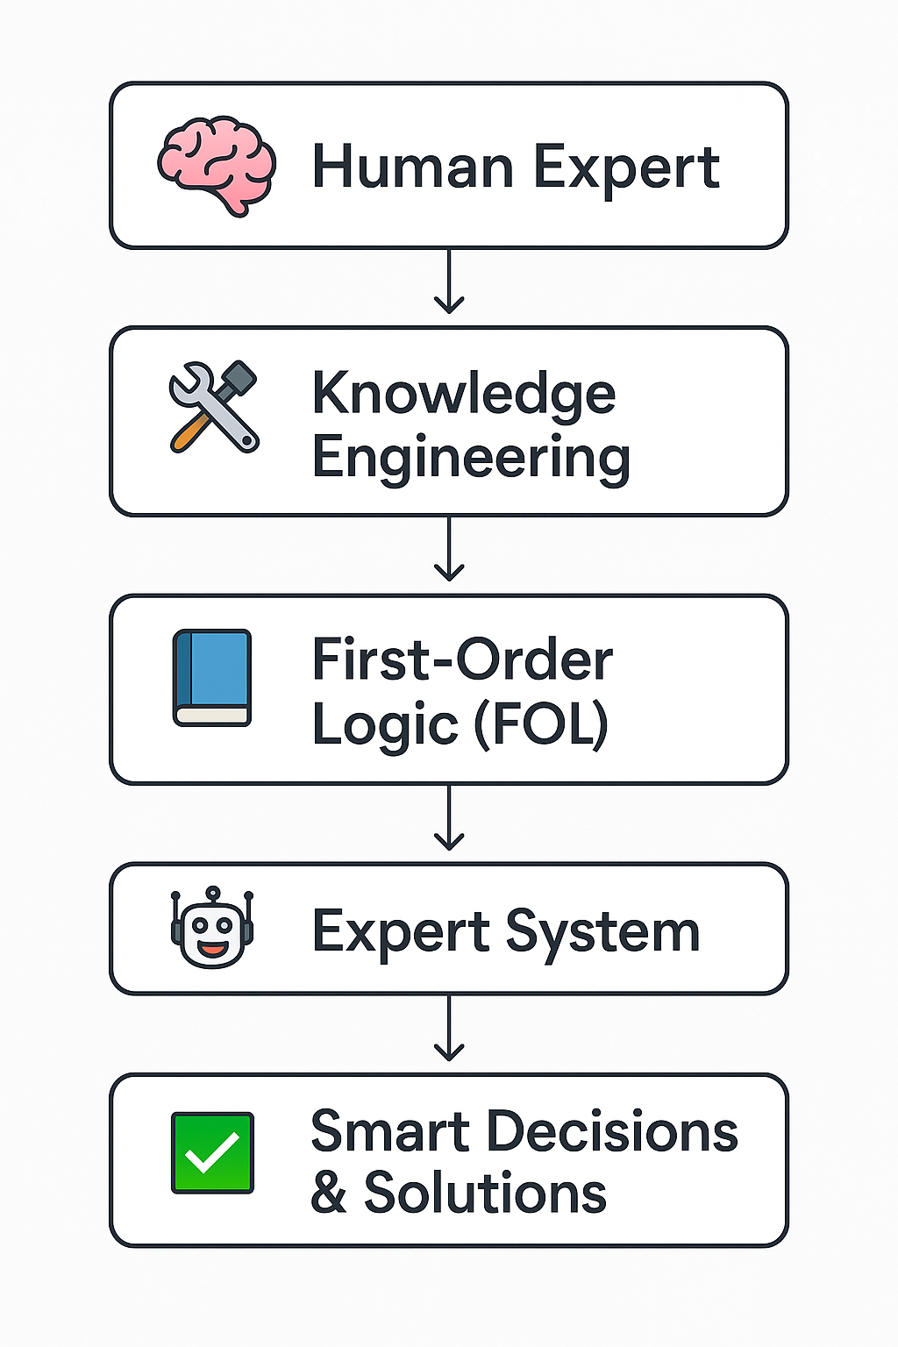
Purpose ?
To help computers think, reason, and solve problems like human experts — using logic

Slide 6
Advantages & DISADVANTAGES
Clear and logical knowledge representation
Handles complex relationships
Strong reasoning and decision-making
More expressive than simple true/false logic
Reusable rules and knowledge
Hard to translate expert knowledge into logic
Struggles with uncertain/incomplete data
Complex and hard-to-manage rules
Slow with large rule sets
Not easy for non-tech users

Slide 7
APPLICATIONS
Medical Diagnosis — Helping doctors identify diseases
Engineering — Troubleshooting machines and systems
Law — Assisting with legal decisions and case analysis
Finance — Fraud detection and risk assessment
Customer Support — Automated help desks and advice
Education — Intelligent tutoring systems

